Slide 1
ENTERTAINER DATA ANALYTICS INTERNSHIP PROJECT REPORT
ANSHIKA BHATNAGAR

Slide 2
TABLE OF CONTENT
1- PROJECT OVERVIEW
2- INTRODUCTION
3- PROJECT OVERVIEW
4-DETAIL ABOUT PROJECT
5- TOOL USE
6-DATASET OF PROJECT
7-MY DASBOARD DESIGN

Slide 3
PROJECT OVERVIEW
I have done this project as part of the Unified Mentor Internship. If you are looking for some remote internship opportunity you can check out UNIFIED MENTOR , where you can find internship for different technologies in different domains.

Slide 4
INTRODUCTION
Normal life can be stressful, and people need to relax. Being entertained by others is a wonderful way to take some time out of life. It can reduce stress and make life's issues easier to face. The media and entertainment industry consists of film, television, radio and print. These segments include movies, TV shows, radio shows, news, music, newspapers, magazines, and books. Entertainment industry is a group of sub-industries devoted to entertainment. Entertainment industry is used to describe the mass media companies that control the distribution and manufacture of mass media entertainment

Slide 5
DETAIL ABOUT PROJECT
Entertainer-Basic Info: It consists of list of 70 Entertainers Name, Birth year and Gender
Entertainer-Breakthrough Info: It consists of details about the 70 entertainers like breakthrough year, first major award, breakthrough movie name
Entertainer-Last major work Info: It consists of the details about the 70 entertainers last major work and if died, Year of death details

Slide 6
Tool used
Microsoft Excel
Microsoft Power Bi.

Slide 7
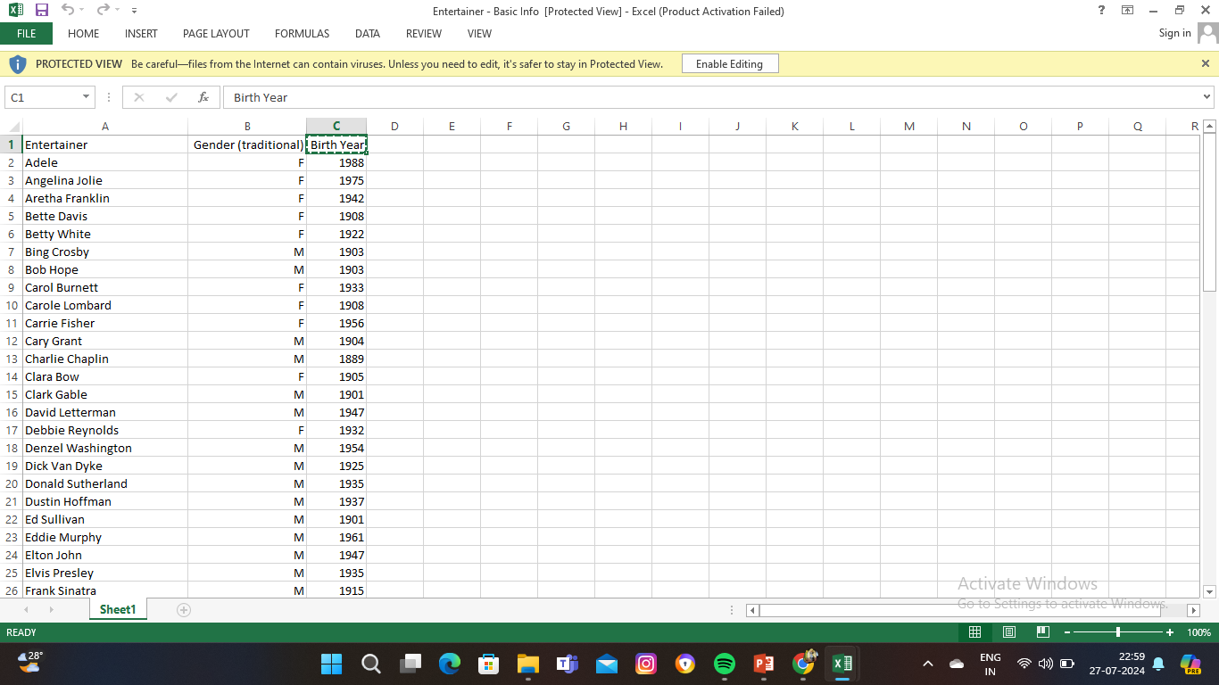
DATASET OF PROJECT

Slide 8
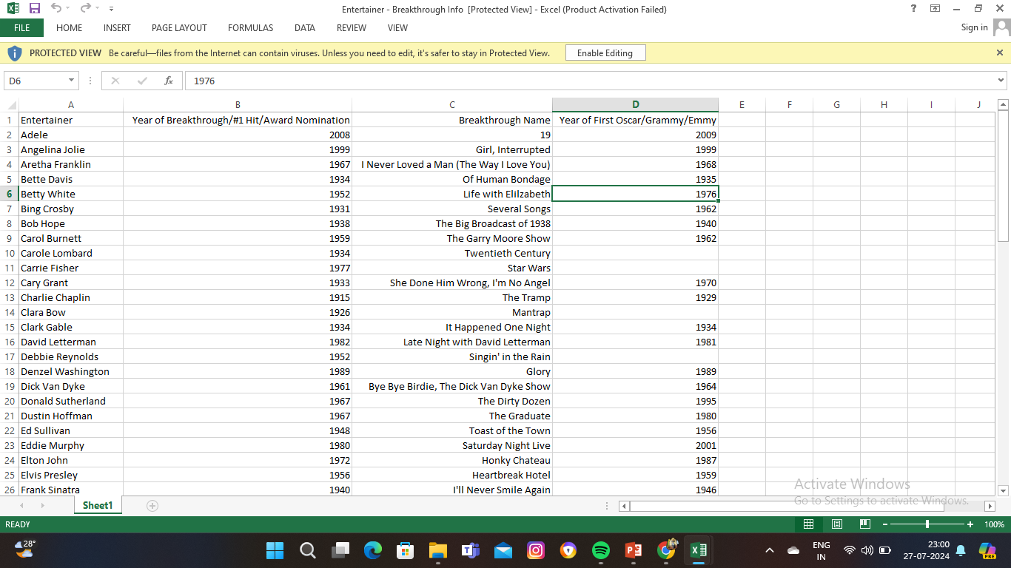
DATASET OF PROJECT

Slide 9
DATASET OF PROJECT

Slide 10
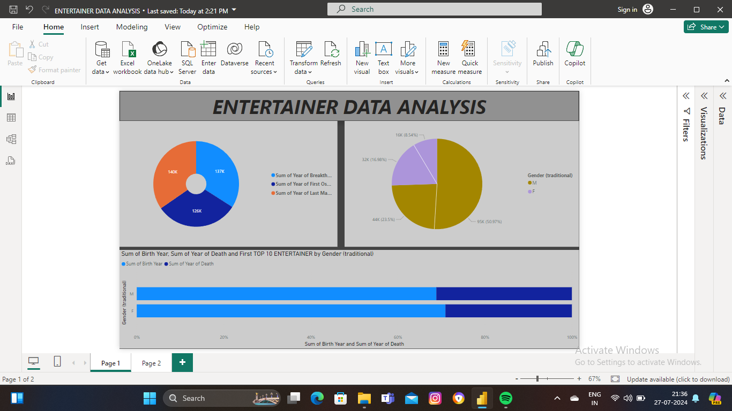
MY DASHBOARD DESIGN

Slide 11
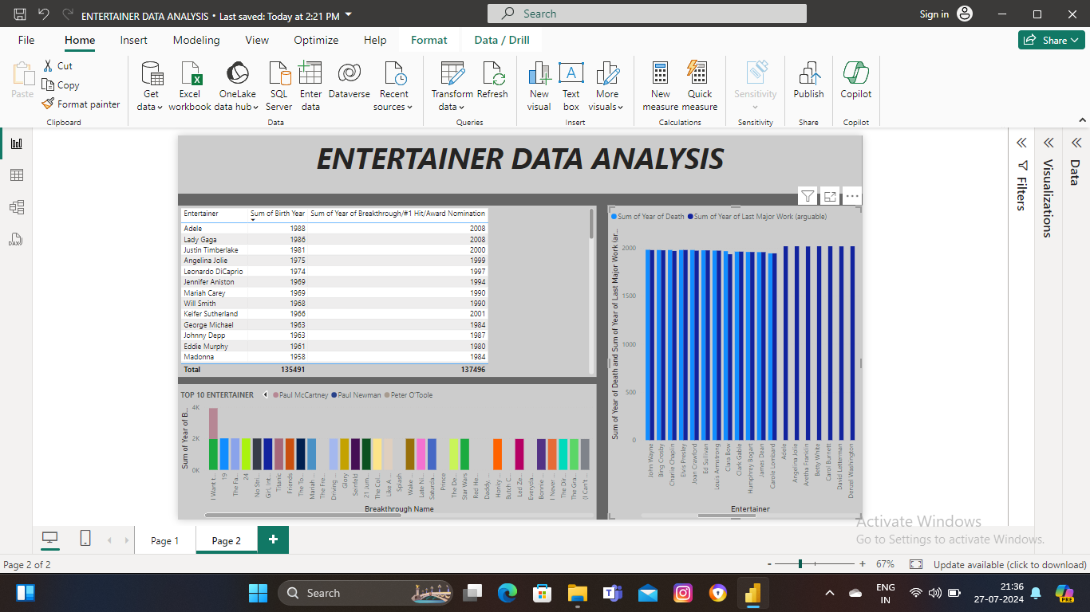
MY DASHBOARD DESIGN

Slide 12
THANKYOU

